Slide 1
Digital Portfolio
STUDENT NAME: R.DINESH
REGISTER NO AND NMID: 5EFA86015C76366B8894FE059215507B
DEPARTMENT:Bsc, Computer Science
COLLEGE: SHANMUGA INDUSTRIES ARTS AND SCIENCE COLLEGE/ UNIVERSITY:THIRUVALLUVAR UNIVERSITY

Slide 2
PROJECT TITLE
"Personal Portfolio Website using HTML, CSS, and JavaScript"

Slide 3


AGENDA
Problem Statement
Project Overview
End Users
Tools and Technologies
Portfolio design and Layout
Features and Functionality
Results and Screenshots
Conclusion
Github Link
3/21/2024 Annual Review

Slide 4

PROBLEM STATEMENT
today’s digital era, professionals need a strong online presence to showcase their skills, projects, and experiences. A traditional résumé often limits creativity and interactivity. Therefore, there is a need for a personal portfolio website that highlights an individual’s expertise and provides an easy way for potential clients, employers, or collaborators to learn more and get in touch.

Slide 5

PROJECT OVERVIEW
This project is a personal portfolio website built with HTML, CSS, and JavaScript. The website provides an overview of the developer, showcases projects, and includes a functional contact form (currently simulated with a success message). The layout is modern, responsive, and user-friendly, designed to leave a positive first impression on visitors.

Slide 6

WHO ARE THE END USERS?
Recruiters and employers looking for web developers Clients who want to hire for freelance projects Peers or collaborators interested in projects

Slide 7

TOOLS AND TECHNIQUES
HTML5 for structure CSS3 for styling and layout JavaScript for form interaction Simple responsive design principles

Slide 8
POTFOLIO DESIGN AND LAYOUT
Header with navigation (About, Projects, Contact) About section describing the developer Projects section showcasing work samples with links Contact section with a functional form Footer with copyright
8

Slide 9
FEATURES AND FUNCTIONALITY
Responsive and clean layout Navigation menu with internal links Contact form with basic JavaScript validation and status message Showcasing projects with demo links

Slide 10


RESULTS AND SCREENSHOTS

Slide 11
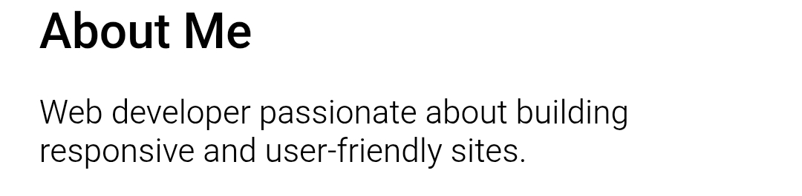
RESULTS AND SCREENSHOTS
3/21/2024 Annual Review
10

Slide 12
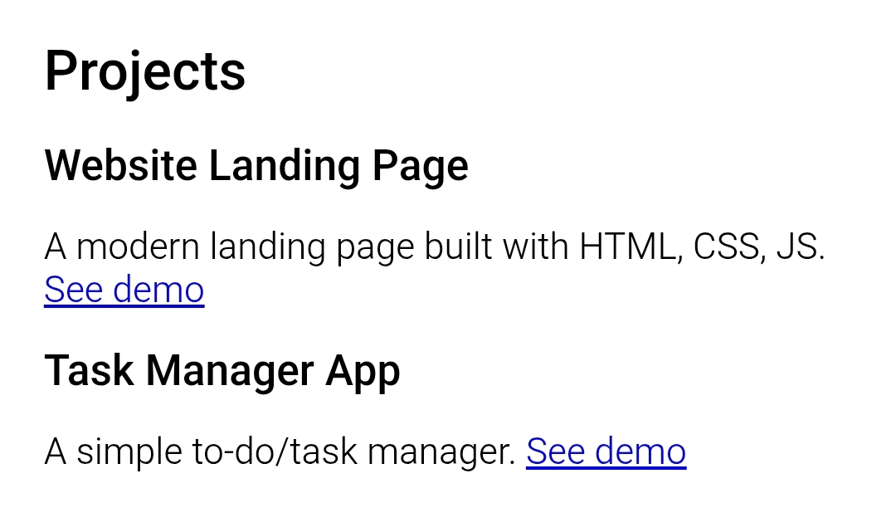
RESULTS AND SCREENSHOTS

Slide 13
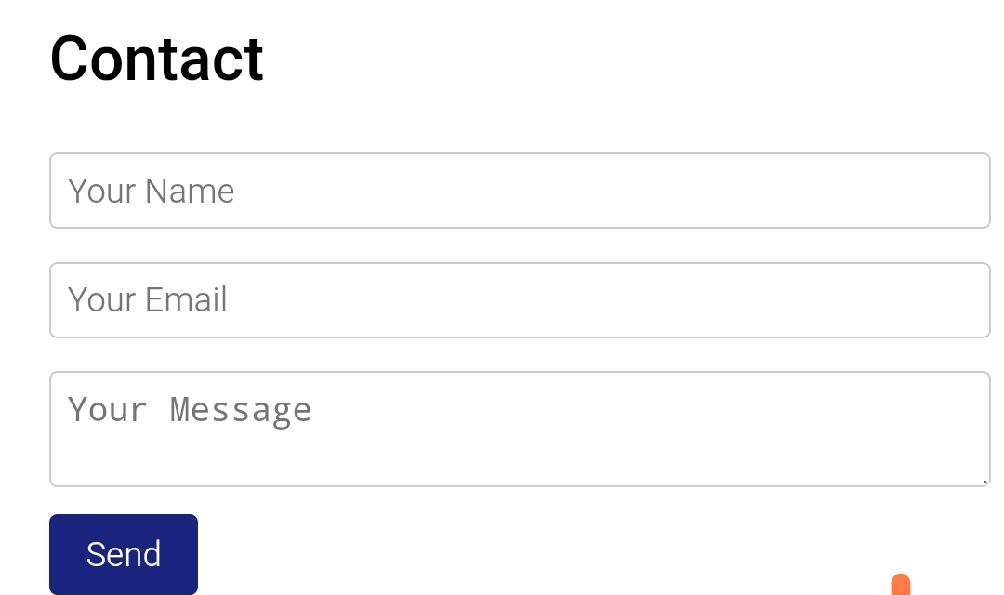
RESULTS AND SCREENSHOTS

Slide 14
CONCLUSION
This portfolio website is a professional way to present skills and projects. It is simple, user-friendly, and provides easy access for employers or clients to connect.
11

